Slide 1

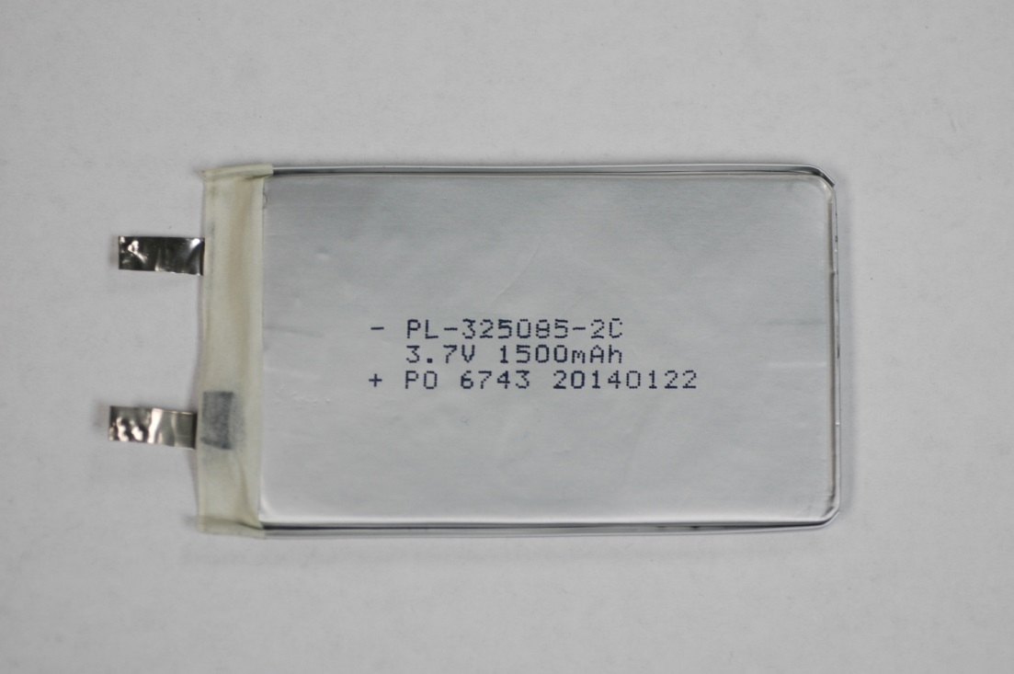
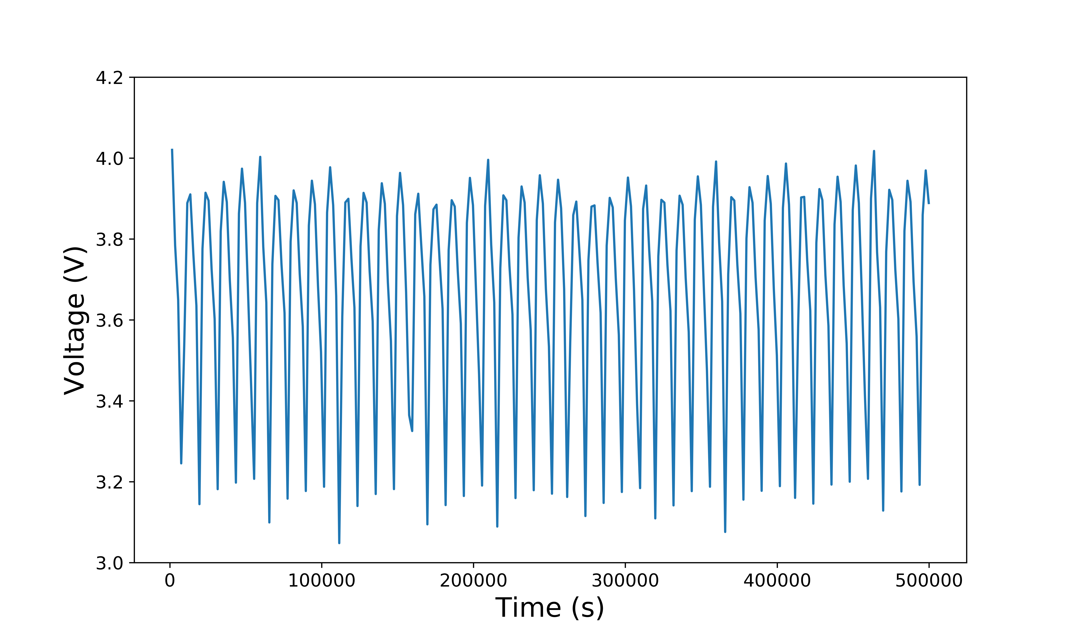
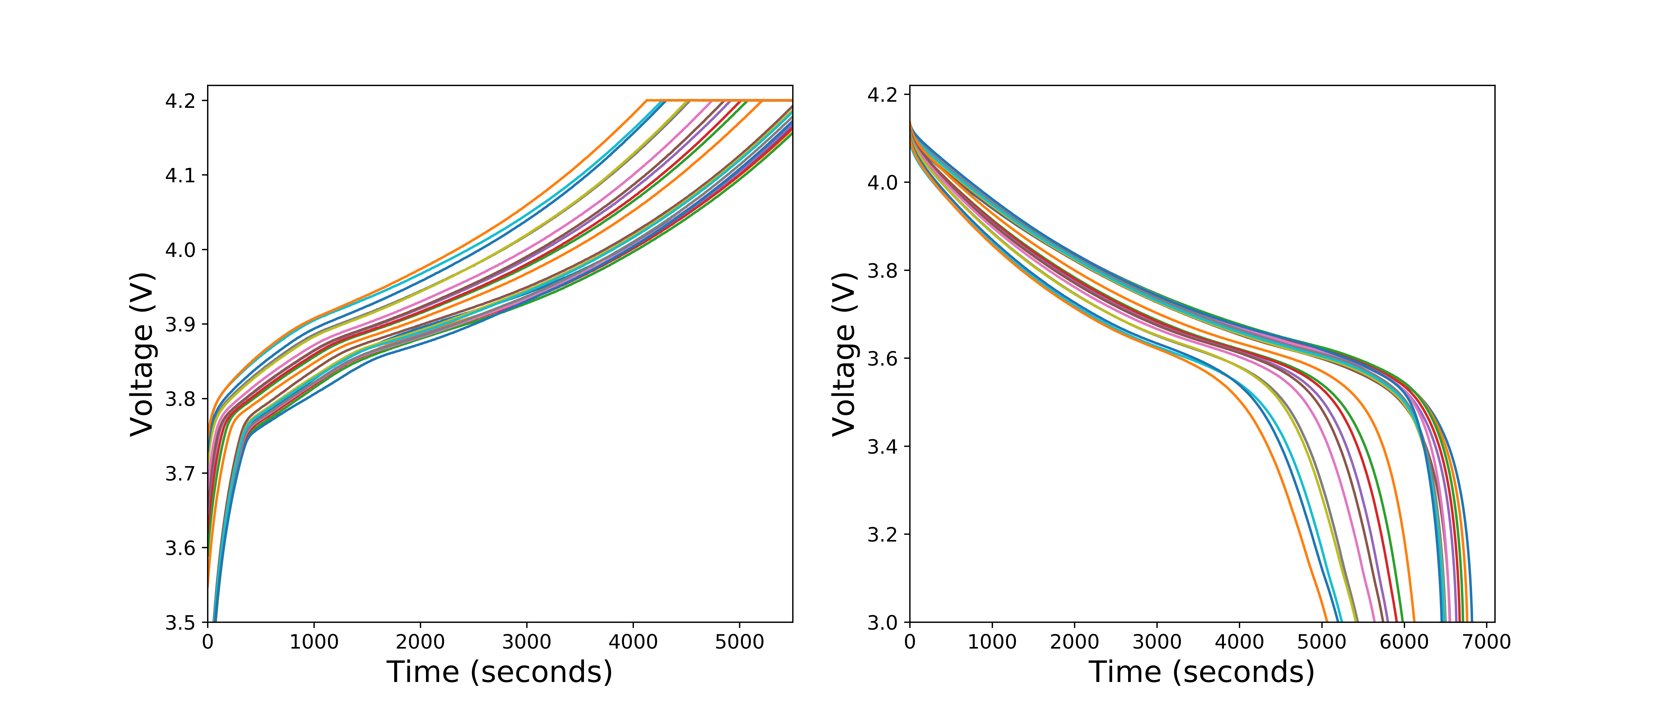
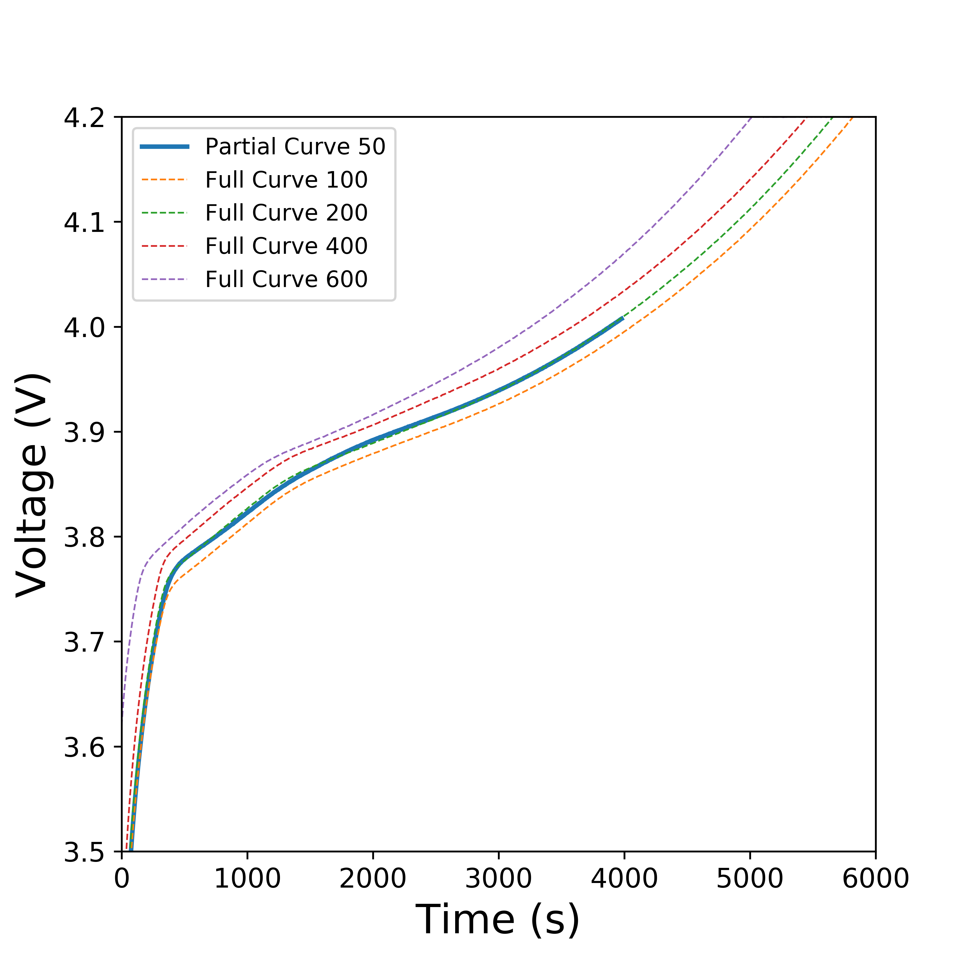
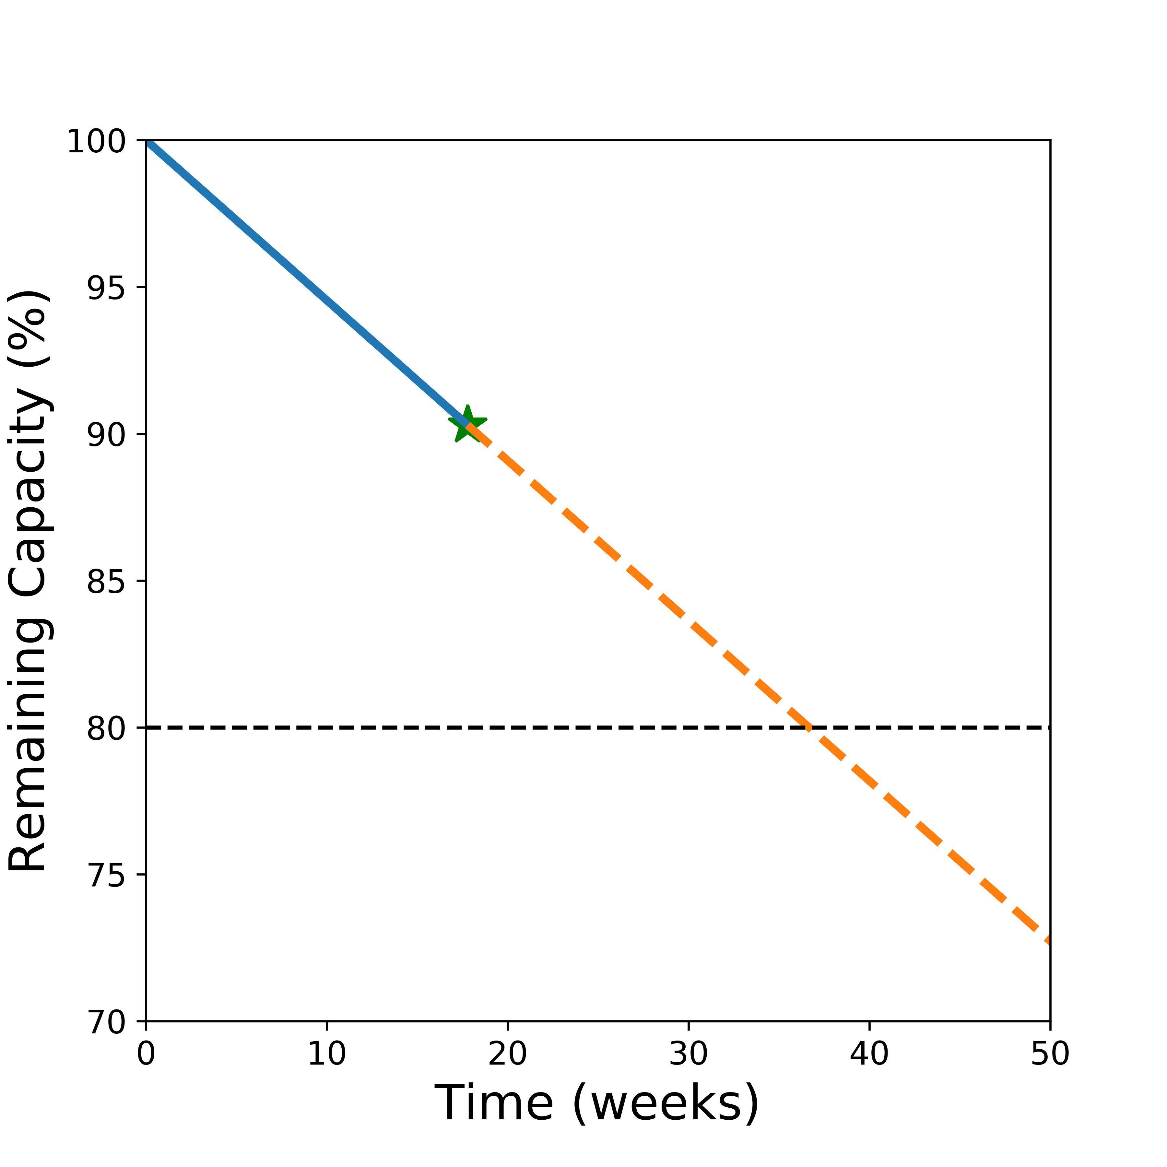

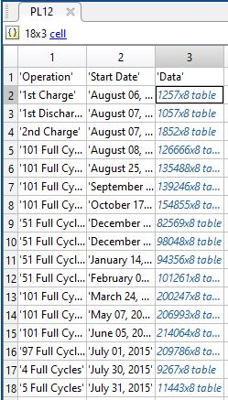
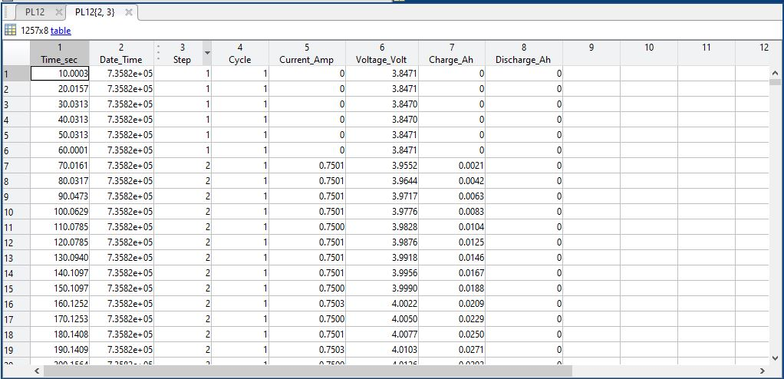

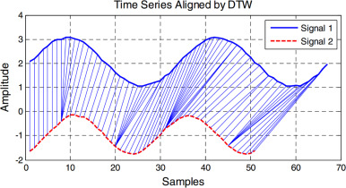






Predicting usable lifetime of lithium-ion batteries
Victor W. Hu, Yusong Liu, Rossana Scavone, Maitri Uppaluri
What Is PULOLB?
predict_capacity:
How Does The Package Work?
PULOLB is a software package, developed in python that can predict the lifetime of a battery (1) based on the capacity, determined from its charge and discharge data. The software is designed to also predict the lifetime when the battery has been partially charged and discharged (for example, the battery is discharged from 60% to 0% state of charge).
distance_cycle_to_full:
partial_to_full:
get_capacity:
get_lifetime:
The calce battery group has data of full charge/discharge curves across cycles that can be used to predict the cycle, the capacity and the lifetime of the user’s battery.
The distance between the two time series are calculated using DTW, and using the KNN algorithm, the full curve that has the closest distance to the partial curve gives its cycle number.
The given partial charge or discharge curve is fitted into the bunch of full curves to predict the cycle number of the partial curve.
Once the corresponding cycle number is predicted, the capacity of the battery is determined. The lifetime of the battery can be calculated from the capacity.
The package finally gives an output that describes the actual battery status and predicts the remaining lifetime, giving a estimate time of failure (2)
Percentage of remaining capacity of the battery.
A graphite/LiCoO2 pouch cell
Plot of the cycling data of a battery operating from the range 0 to 60% SOC.
import_data:
Data Cleaning
Prediction of the battery’s lifetime.
sort_data:
Create a GUI for the user to input data more effectively.
Expand the import_data function to allow different kinds of input files to be read and implemented.
Improve speed of the code by trying other machine learning algorithms.
Improve the accuracy of the cycle, capacity and lifetime prediction of the battery.
Better methods to extrapolate data for a more accurate prediction of the battery’s lifetime.
Packages Used To Develop The Machine Learning Code
Future Work
Packages used for data cleaning:
Dynamic Time Warping
hdf5storage:
A package that can read/write HDF5 (Hierarchical Data Format) files. The data is classified into HDF5 groups, which contain HDF5 datasets that can be read as numpy arrays. Each dataset is stored inside a dictionary.
h5py:
Required for full functionality of hdf5storage.
The distance between the two time series are calculated using DTW. For this project, the Euclidean distance between the two time series was calculated.
Functions used to clean the data:
import_data:
Converts the .mat files into pandas dataframes, with each cycle data cumulatively added (3)
sort_data:
Sorts the data in the pandas dataframe by cycle number, stores this data as a dictionary with the cycle number as the key.
Seperates the charge and discharge data.
single_pd_matlab_data:
by_cycle:
charge_discharge:

Slide 2
What our machine learning is: Dynamic Time Warping using FastDTW
Logo?
Using a KNN of sorts to sort distances to return full curve
Used DTW in KNN to find the closest distances.
DTW requires us to filter our voltages to min-max of partial curve, for better prediction.
From the corresponding full curve, it calculates the capacity and hence the lifetime.
Ultimate goal of the user: Input any partial data curve and have our package predict the best corresponding full curve

